Slide 1

DESIGN,DEVELOPMENT AND ACOUSTIC ANALYSIS OF NORMAL AND LOMBARD SPEECH TAMIL CORPUS
NAVEEN K
B TECH INFORMATION TECHNOLOGY
ANJALAI AMMAL MAHALINGAM ENGINEERING COLLEGE

Slide 2


Introduction
Welcome to the project presentation on the Design, Development, and Acoustic Analysis of Normal and Lombard Speech Tamil Corpus. This project focuses on creating a comprehensive dataset of Tamil speech under normal conditions and Lombard effect (speech in noisy environments). By analyzing this corpus, we aim to understand the acoustic characteristics and variations in speech patterns, which can significantly enhance speech recognition systems and improve communication technologies in noisy settings.

Slide 3

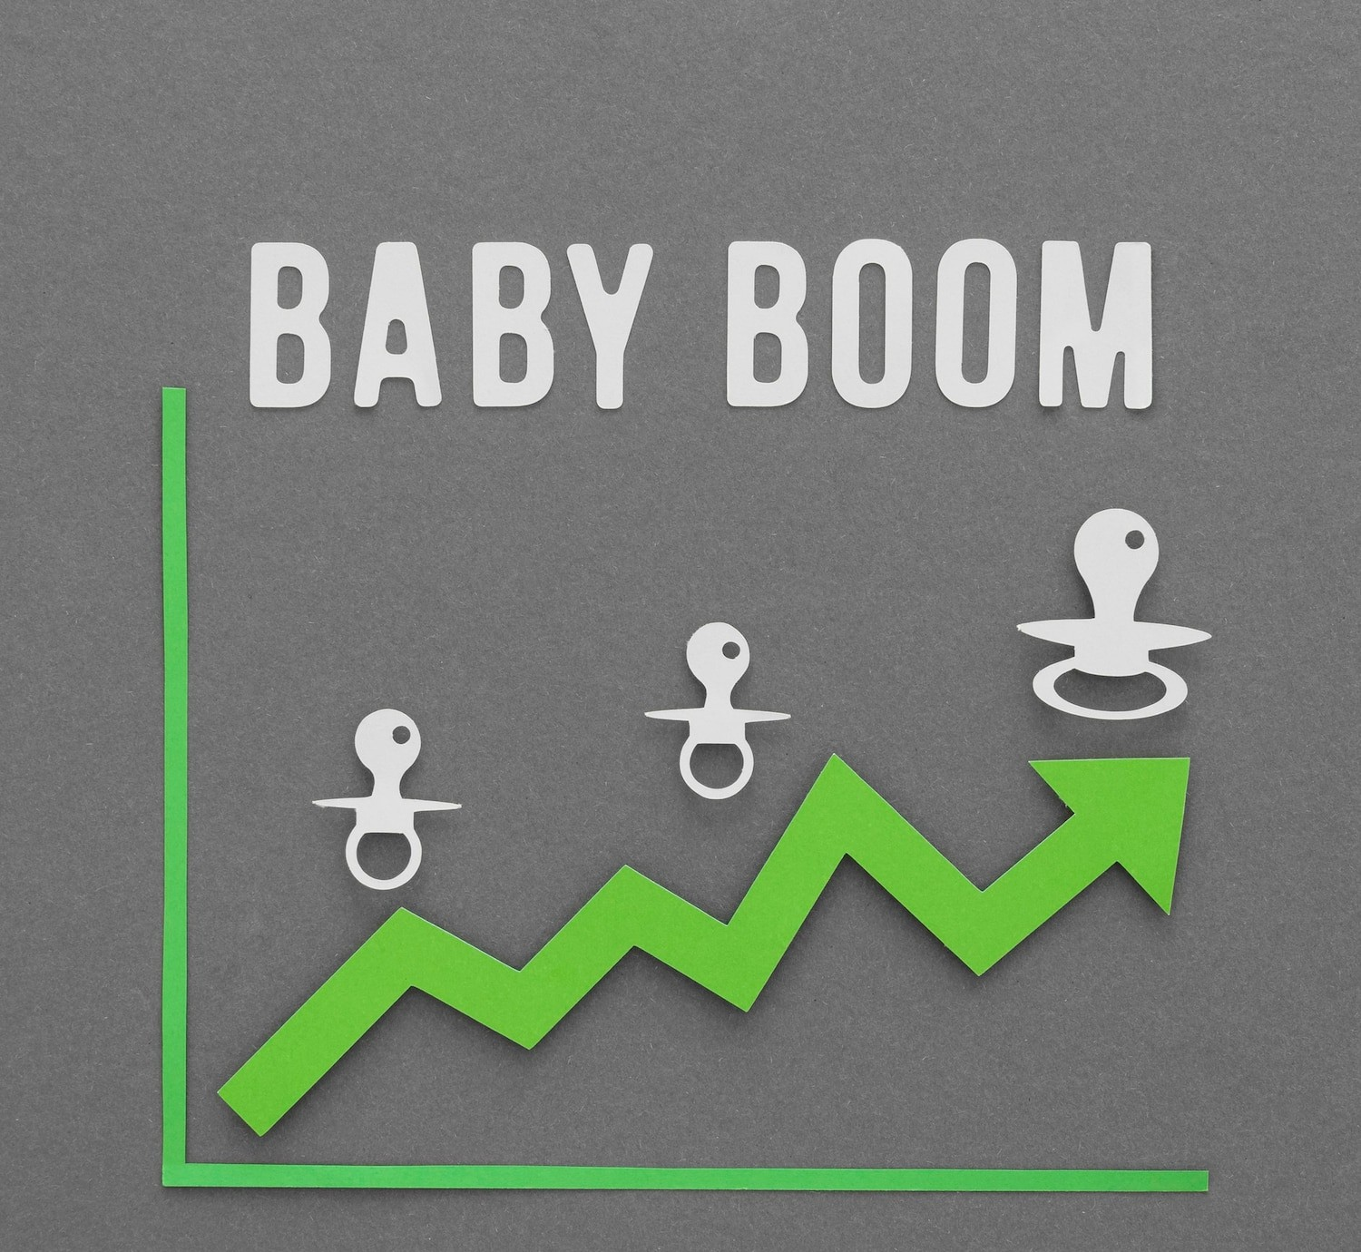
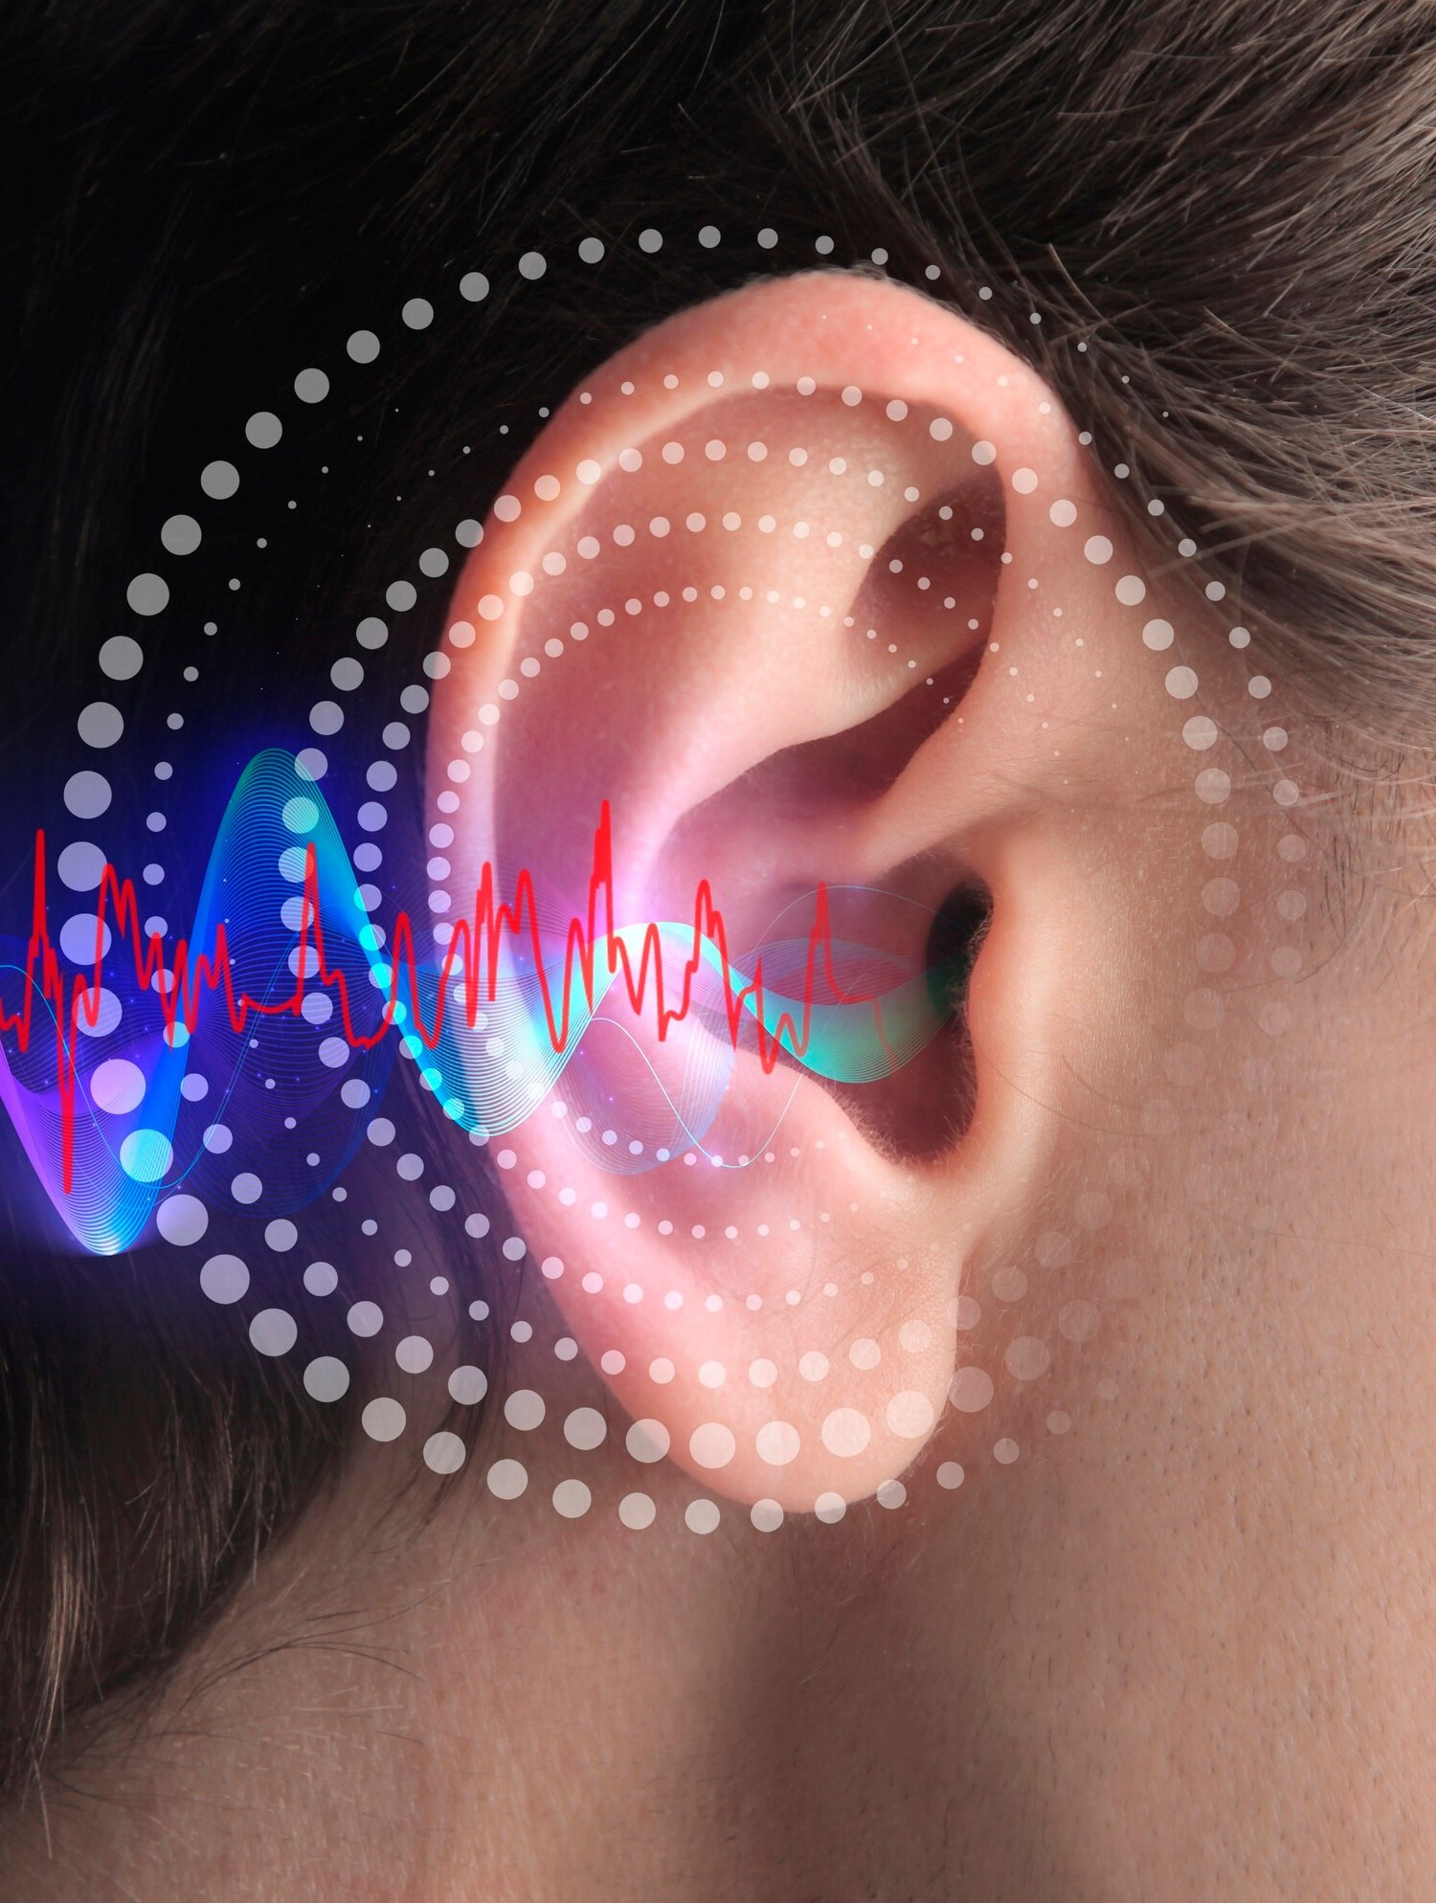
Understanding Normal and Lombad speech
Normal speech refers to the way people talk in a quiet environment, characterized by natural volume, pitch, clear pronunciation, and a typical speech rate and rhythm.
In contrast, Lombard speech occurs when people speak in noisy environments, automatically adjusting their speech to be heard over the noise. This adjustment results in increased volume and pitch, a slower speech rate, and enhanced articulation of words. Understanding these variations is crucial for improving speech recognition systems and designing better communication devices that can function effectively in noisy environments.

Slide 4

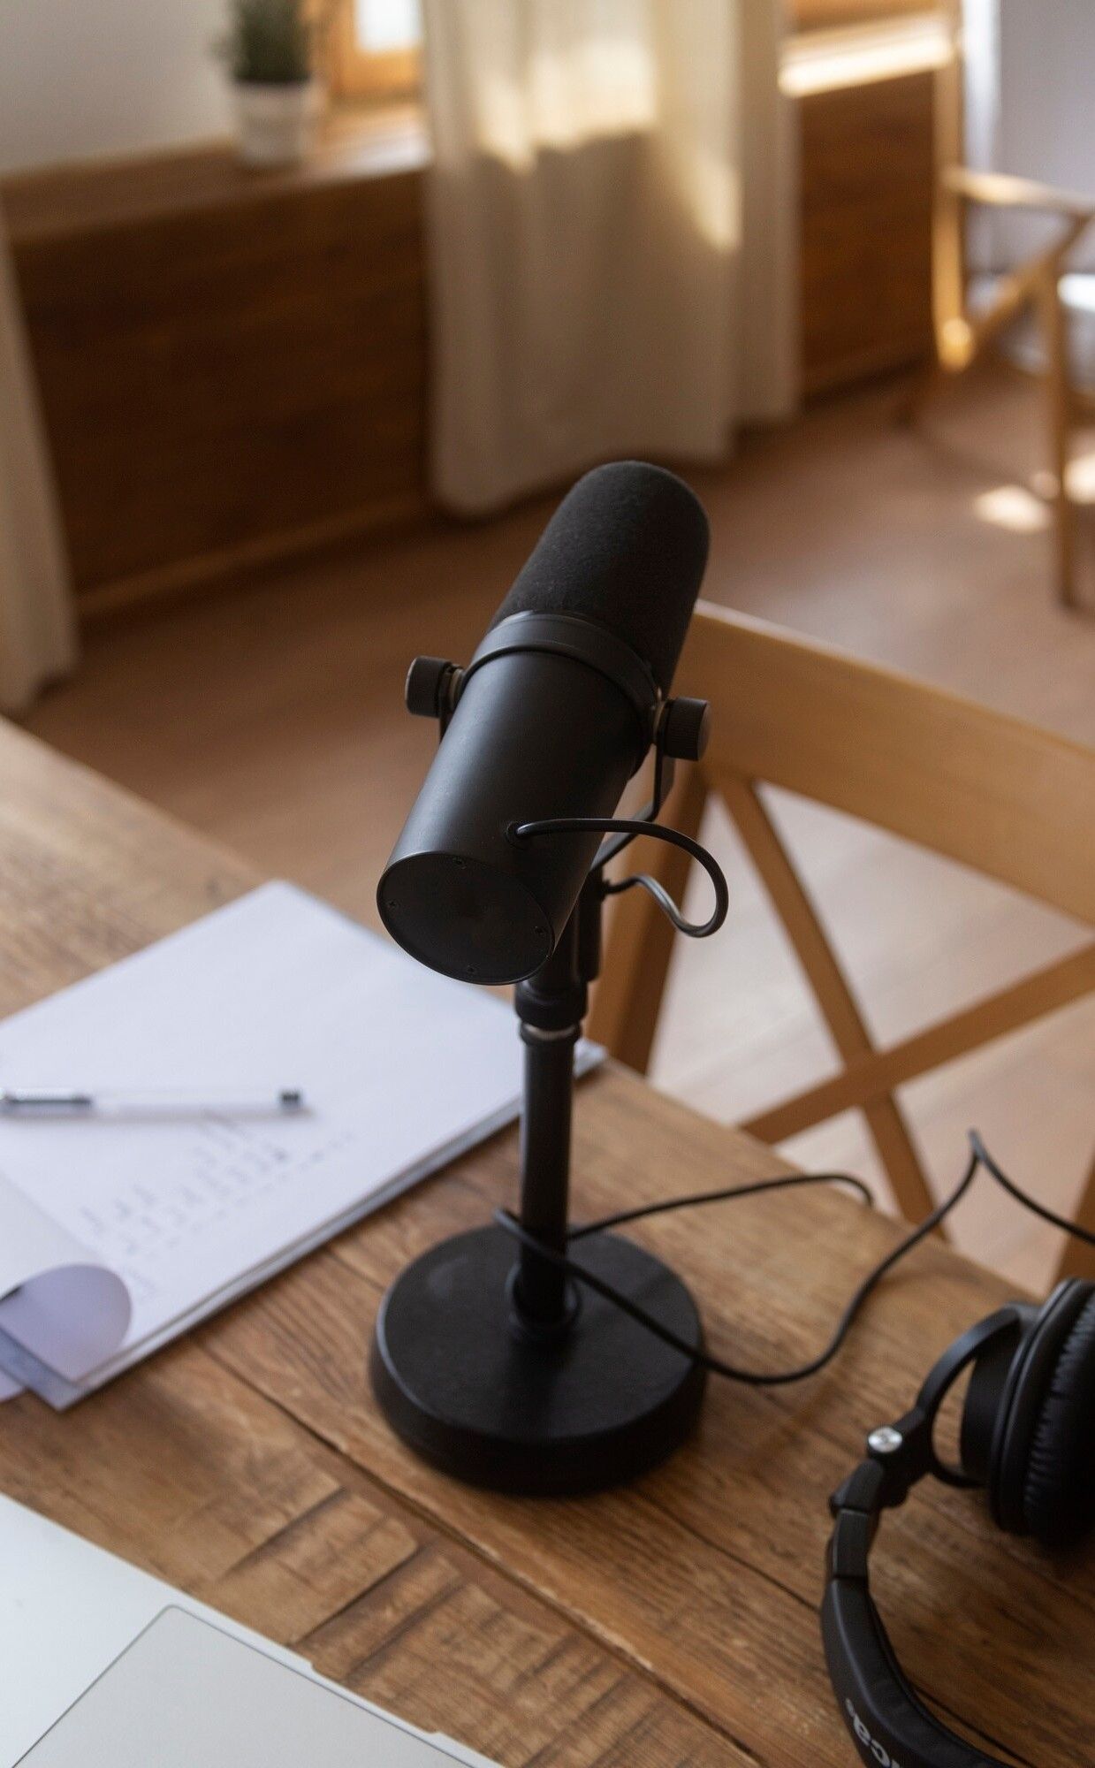
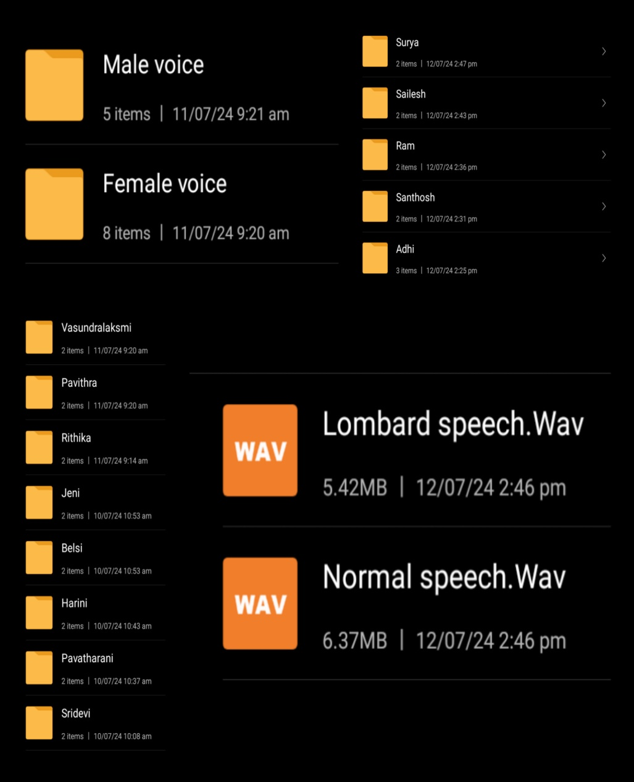
Data Collection Methodology
The data collection methodology for this project involves several key steps to ensure a comprehensive and accurate corpus of Normal and Lombard speech in Tamil. First, we recruited a diverse group of native Tamil speakers to participate in the recording sessions. For normal speech, participants were asked to read a set of predefined sentences in a quiet environment, ensuring natural speaking conditions. For Lombard speech, the same participants were recorded while reading the same sentences, but this time with background noise introduced through headphones to simulate noisy environments. The noise levels were varied to capture different degrees of Lombard effect. All recordings were conducted using high-quality microphones in a controlled acoustic setting to ensure clarity and consistency.

Slide 5

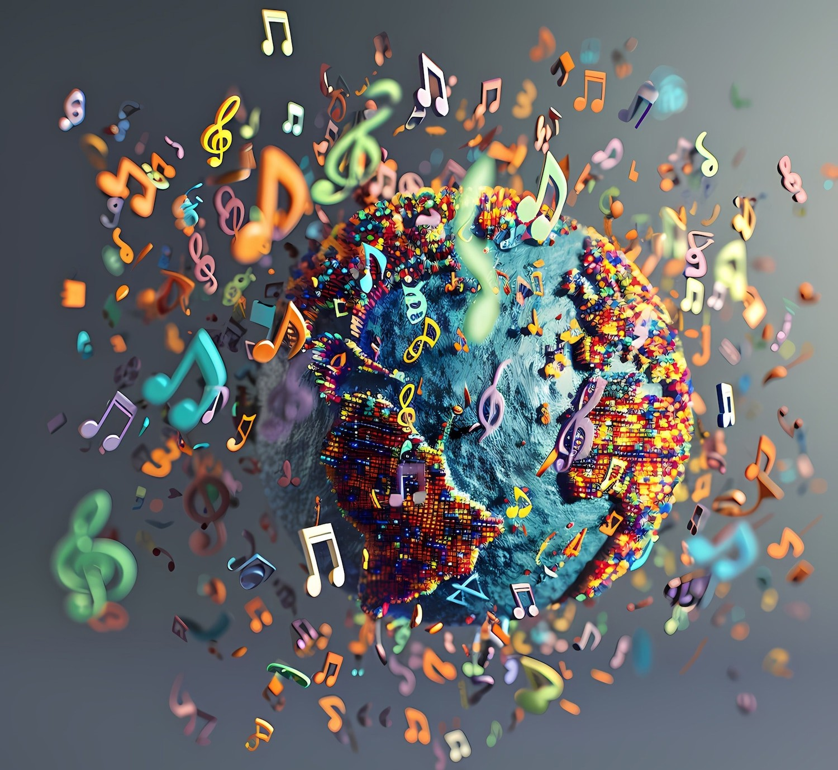
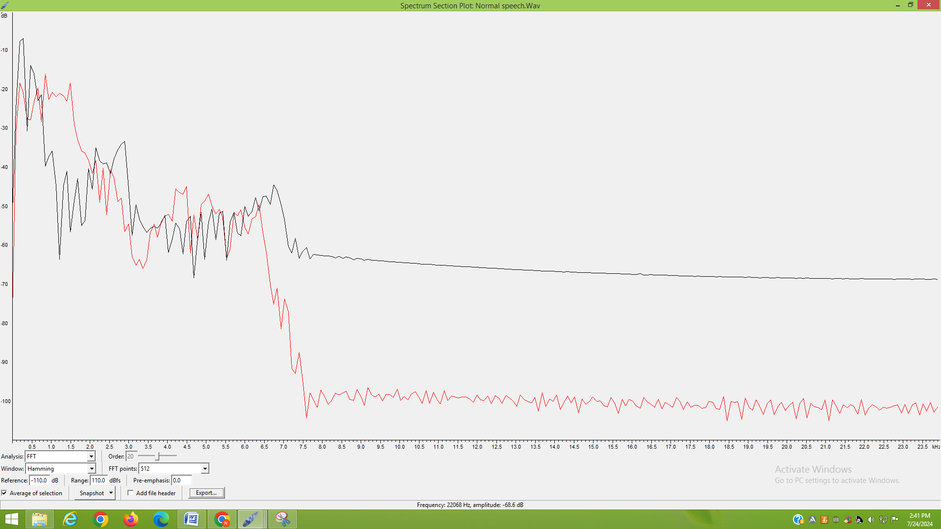
Feature Extraction Techniques
Feature extraction involves identifying key acoustic features such as pitch, intensity, and formants. These features are critical for distinguishing between normal and Lombard speech. We employed techniques like MFCC and spectral analysis to enhance our model’s performance.

Slide 6
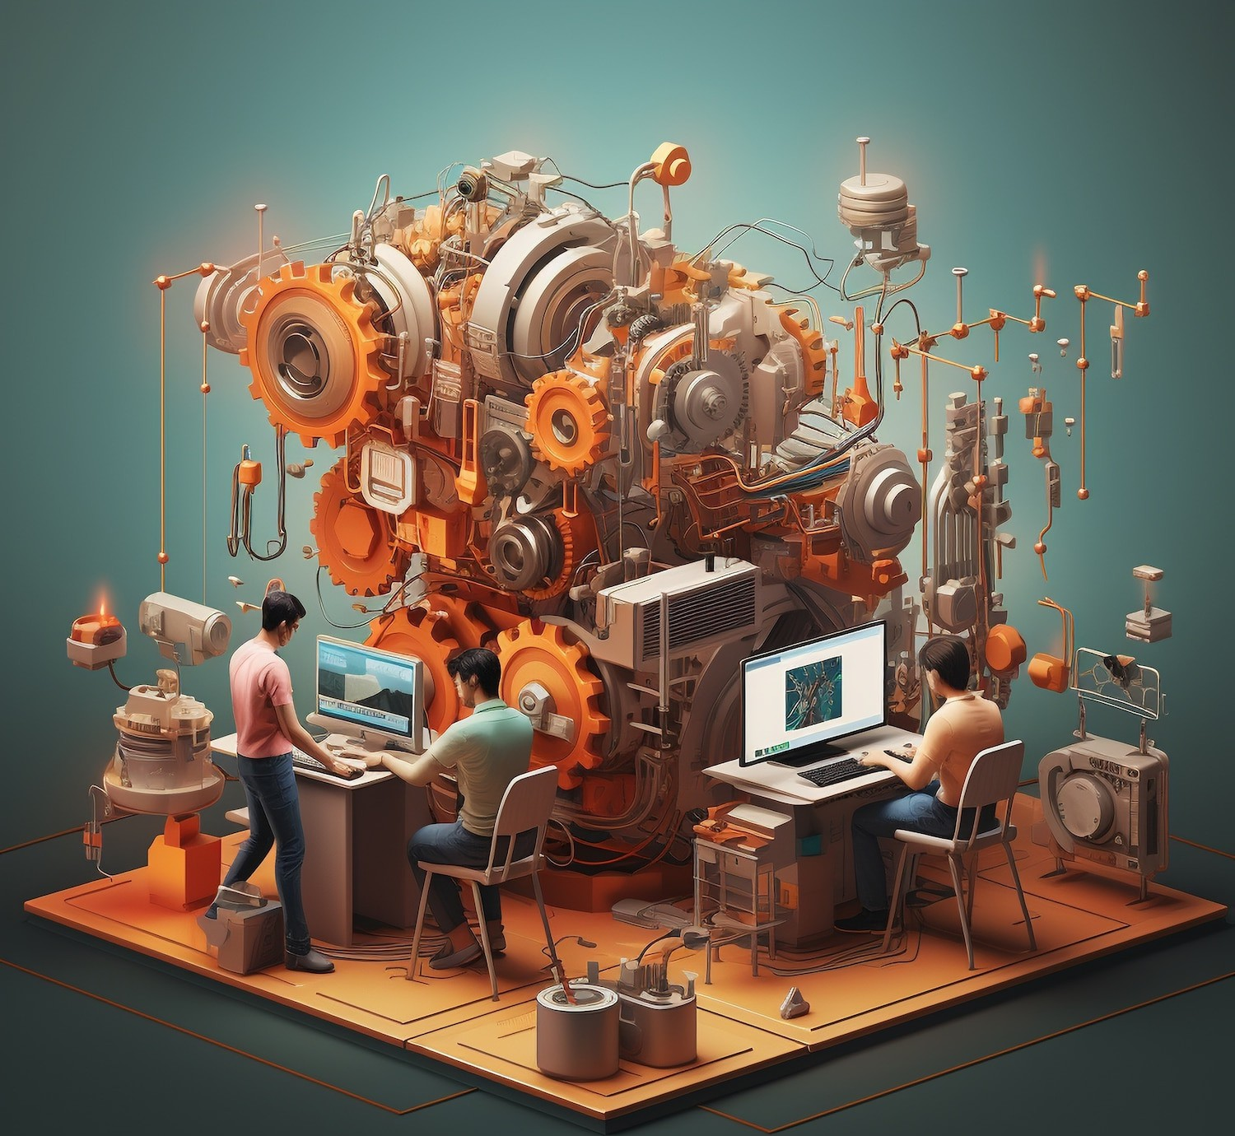
Machine Learning Overview
In this project, we utilize a Multi-Layer Perceptron (MLP) for the classification of Normal and Lombard speech. Key audio features like MFCCs, chroma features, and spectral contrast are extracted from the recordings. The MLP consists of an input layer, three hidden layers with 256, 128, and 64 neurons using ReLU activation, and dropout layers to prevent overfitting. The output layer uses a sigmoid activation for binary classification. Trained with binary cross-entropy loss and the Adam optimizer over 50 epochs, the model effectively differentiates between normal and Lombard speech, aiding in enhanced speech recognition and communication technologies.

Slide 7


Model Training and Evaluation
The Model is trained by using MLP(Multi Layer Perceptron). The model’s performance is evaluated using metrics like accuracy, precision, recall, and F1-score. Post-training, the model provides probabilities for each class, enabling precise classification. This robust training and evaluation process ensures the model's effectiveness in differentiating speech types, improving speech recognition systems in noisy environments.

Slide 8
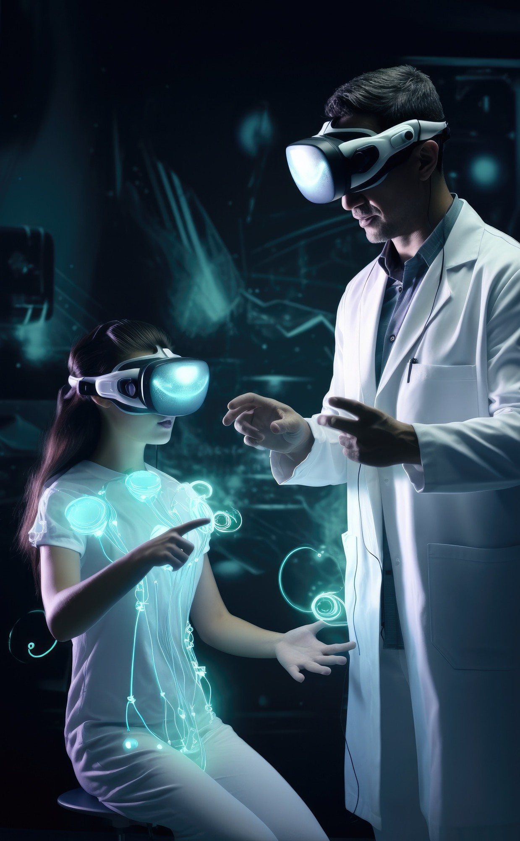
Applications of Findings
.
The findings from this project have several key applications.
Enhanced Speech Recognition: Improved accuracy in recognizing and processing Tamil speech in both quiet and noisy environments. Communication Devices: Better performance of devices like hearing aids and mobile phones in noisy settings.
Assistive Technology: Enhanced tools for individuals with speech or hearing impairments.
AI and Robotics: Improved human-machine interaction by understanding speech variations.
Linguistic Research: Deeper insights into the acoustic characteristics of Tamil speech under different conditions, aiding linguistic studies and education.

Slide 9

Conclusion and Future Work
In conclusion, this project successfully developed a comprehensive Tamil speech corpus for both normal and Lombard speech, utilizing an MLP model to accurately classify speech types. The findings contribute to improved speech recognition and communication technologies. Future work includes expanding the dataset to cover more speakers and different noise conditions, enhancing the model’s robustness. Additionally, exploring other machine learning models and feature extraction techniques can further improve classification accuracy. Collaborating with linguistic researchers and integrating the model into real-world applications are also promising directions.

Slide 10



Thanks!

